Slide 1
LLMTaxo: Leveraging Large Language Models for Constructing Taxonomy of Factual Claims from Social Media
Haiqi Zhang, Zhengyuan Zhu, Zeyu Zhang, Chengkai Li
The University of Texas at Arlington
The 63rd Annual Meeting of the Association for Computational Linguistics (ACL 2025)
Vienna, Austria July 27–August 1st, 2025
Presented by: Haiqi Zhang

Slide 2
LLMTaxo: Domain-Specific, Multi-Level Taxonomy of Factual Claims from Social Media
Help understand and analyze vast and diverse social media content
First LLM-based automation framework for such taxonomy
First multi-level (broad, medium, and detailed) taxonomy for factual claims

Slide 3
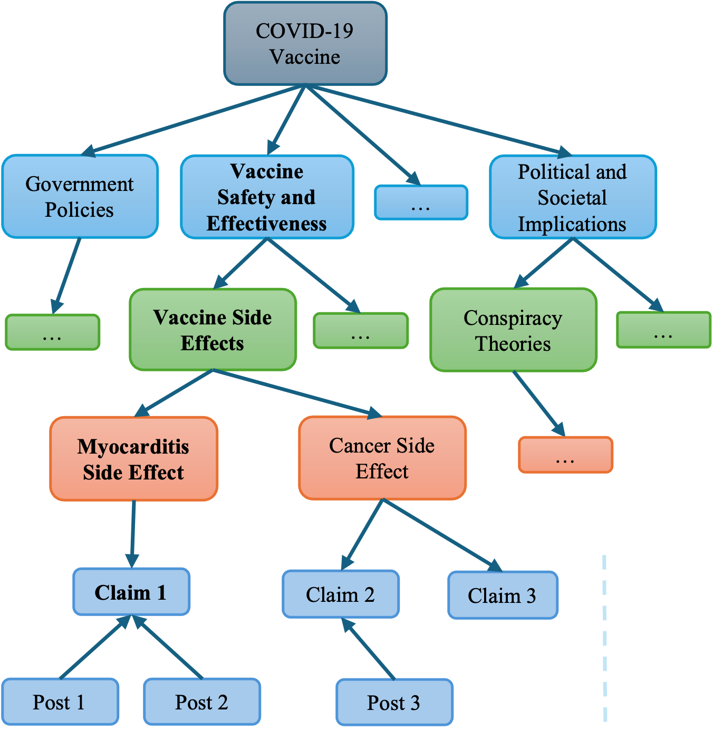

LLMTaxo Framework Overview
Social Media Posts
Factual Claims
Distinct Factual Claims
Claim Detection
Distinct Claim Identification
LLM-based Taxonomy Construction

Slide 4



LLMTaxo Framework
Social Media Posts
k Learning Examples
Seed Taxonomy
Taxonomy
Vaccine Safety …
… Side Effects
Myocarditis …
COVID-19 Vaccine
Vaccine Safety …
Vaccine Safety …
… Side Effects
Cancer …
Claim Detection
ClaimBuster
Claim 1
… Side Effects
…
Myocarditis …
Political and …
Conspiracy …
Vaccine Injury
Factual Claims
Vaccine Safety …
Generated Results
Government Policies​
Vaccine Safety and Effectiveness​
Political and Societal Implications​
Claim 2
… Side Effects
…
Cancer …
Vaccine Safety …
…
Claim 1
… Side Effects
Government Policies
Prompt
Myocarditis …
Vaccine Side Effects​
Conspiracy Theories
Sentence-BERT
Claim k
Vaccine Mandates
1) Instruction
2) Learning examples
3) Seed taxonomy
4) Distinct factual claim
…
…
…
Opposition …
Vaccine Safety …
Claim 2
… Side Effects
Vector Representations
Cancer …
Myocarditis Side Effect
Cancer Side Effect
…
…
Political and …
Claim n
Conspiracy …
HDBSCAN
m Random Samples
Vaccine Injury
Claim 1
Claim 2
Claim 3
n Distinct Factual Claims
LLM
n Clusters
Myocarditis is up TEN times due to the Covid Vaccine...
Post 1
Post 2
Post 3
Distinct Claim Identification

Slide 5
Datasets
To assess the framework, we experimented on three datasets:
COVID-19 Vaccine (CV): tweets collected using the in-house tool Wildfire. Keywords: “covid-19 vaccine” and it variations, such as “covid vax.”
Climate Change (CC): Facebook posts collected using CrowTangle. Keyword: “climate change.”
Cybersecurity (CS): Facebook posts collected using CrowTangle. Keyword: “cybersecurity.”
Dataset | Source | Raw Posts | ClaimBuster Score>0.5
CV | Twitter | 384,676 | 232,368
CC | Facebook | 229,913 | 89,412
CS | Facebook | 107,905 | 38,530

Slide 6
Clustering
Cluster identical and highly similar claims: Sentence-BERT + HDBSCAN
Dataset | Posts | Clusters | Outliers
COVID-19 Vaccine (CV) | 232,368 | 10,995 | 25,962
Climate Change (CC) | 89,412 | 15,794 | 42,923
Cybersecurity (CS) | 38,530 | 7,398 | 15,946
Dataset | Silhouette Coefficient
COVID-19 Vaccine (CV) | 0.940
Climate Change (CC) | 0.488
Cybersecurity (CS) | 0.554

Slide 7
Distinct Claim Identification
 | Factual claims
Cluster 1 | The flu shot increases risk of coronavirus by 36%! (distinct claim)
 | They have already been 'flu vaxed which increases the risk of a respiratory coronavirus infection by 36%.
 | A 2020 US Military Study found that getting a flu shot raises your risk of coronavirus by 36% VaccineInjury.
Cluster 2 | Vaccines are full of toxins and carcinogens. (distinct claim)
 | Vaccines are full of toxins and carcinogens.
 | Vaccines are full of toxins and carcinogens, including fetal tissue.
Cluster 3 | It takes years to test vaccines properly. (distinct claim)
 | And It takes years to test vaccines.
Dataset | Distinct Claims
COVID-19 Vaccine (CV) | 10,995
Climate Change (CC) | 15,794
Cybersecurity (CS) | 7,398

Slide 8
LLMTaxo Framework
Social Media Posts
k Learning Examples
Seed Taxonomy
Taxonomy
Vaccine Safety …
… Side Effects
Myocarditis …
COVID-19 Vaccine
Vaccine Safety …
Vaccine Safety …
… Side Effects
Cancer …
Claim Detection
ClaimBuster
Claim 1
… Side Effects
…
Myocarditis …
Political and …
Conspiracy …
Vaccine Injury
Factual Claims
Vaccine Safety …
Generated Results
Government Policies​
Vaccine Safety and Effectiveness​
Political and Societal Implications​
Claim 2
… Side Effects
…
Cancer …
Vaccine Safety …
…
Claim 1
… Side Effects
Government Policies
Prompt
Myocarditis …
Vaccine Side Effects​
Conspiracy Theories
Sentence-BERT
Claim k
Vaccine Mandates
1) Instruction
2) Learning examples
3) Seed taxonomy
4) Distinct factual claim
…
…
…
Opposition …
Vaccine Safety …
Claim 2
… Side Effects
Vector Representations
Cancer …
Myocarditis Side Effect
Cancer Side Effect
…
…
Political and …
Claim n
Conspiracy …
HDBSCAN
m Random Samples
Vaccine Injury
Claim 1
Claim 2
Claim 3
n Distinct Factual Claims
LLM
n Clusters
Myocarditis is up TEN times due to the Covid Vaccine...
Post 1
Post 2
Post 3
Distinct Claim Identification

Slide 9
Topic Generation Sample Results
Dataset | Claim | Broad Topic | Medium Topic | Detailed Topic
COVID-19 Vaccine | John Stockton boldly suggest 'thousands' of pro athletes died after Covid vaccine shot https://t.co/nXbt6Apm2q via @marca | Vaccine Safety and Effectiveness | Vaccine Side Effects | Vaccine-Related Injuries and Deaths
 | A lot of people in ‘stage 4 cancer’ after #Covid #Vaccine https://t.co/z0YAqGgQrL | Vaccine Safety and Effectiveness | Vaccine Side Effects | Cancer Side Effect
Climate Change | Climate change is an existential threat to humanity. On Earth Day and every day, we remain committed to taking the most aggressive climate action ever. | Activism and Public Awareness | Climate Advocacy | Aggressive Climate Action
 | Climate change causes Dry spell in Kashmir, The weather in Kashmir is warmer than Delhi and Chandigarh, No snow rain in Kashmir During Chillai Kalan | Environmental Impact | Global Warming | Climate Change Effects in Kashmir
Cybersecurity | CBN Exempts 16 Items from Cybersecurity Levy…including Salary, Loans, Pension, Donations | Policies and Governance | Government Regulations | Cybersecurity Levy Exemptions
 | Streaming giant Roku has recently been targeted by a pair of cyberattacks, and the company confirmed over a half million Roku accounts were compromised. | Threats | Cyberattacks | Roku Account Compromise

Slide 10
Topic Consolidation
Aggregated the generated topics to construct a taxonomy, using top-down prefix-based induction method.
Claim 1: broad topic: Vaccine Safety and Effectiveness; medium topic: Vaccine Side Effects.
Claim 2: broad topic: Vaccine Safety and Effectiveness; medium topic: Vaccine Injury.
Vaccine Safety and Effectiveness
Vaccine Side Effects
Vaccine Injury

Slide 11
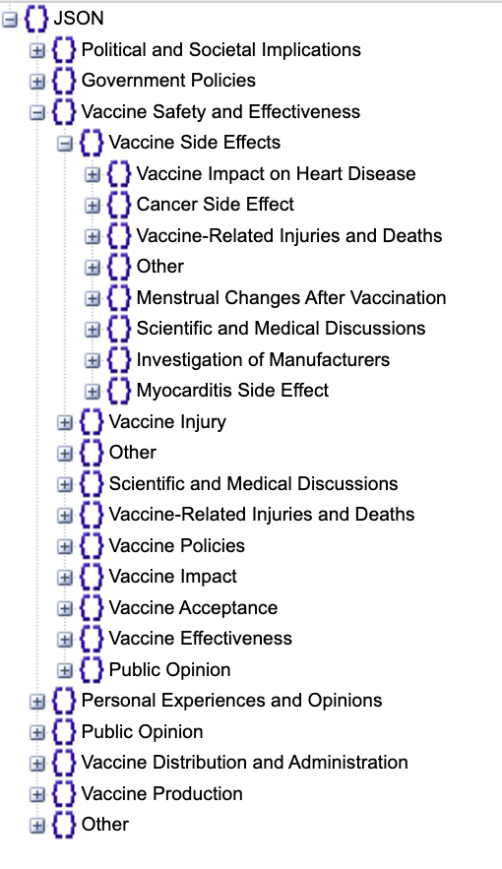
Evaluation
Each topic label uses specific and well-defined terms
Evaluators: 11 human and GPT-4
Taxonomy Evaluation:
Clarity: To assess whether the topic labels are clear, precise, and unambiguous, we evaluate precision, unambiguity, consistency, and accessibility.
Hierarchical Coherence: To assess whether the taxonomy follows a clear and meaningful hierarchical structure, we evaluate gradational specificity, parent-child coherence, and consistency.
Orthogonality: To assess whether the topics are well-differentiated without duplication, we evaluate distinctiveness and non-overlap.
Completeness: To assess whether the taxonomy captures a broad and representative set of topics across different aspects of the domain, we evaluate domain coverage, depth, and balance.

Slide 12
Evaluation
Claim-topic Alignment Evaluation:
Accuracy: Assess how accurately the leaf node topics reflect the content and context of the corresponding factual claims.
Granularity: Evaluate the specificity of the leaf node topics.
COVID-19 Vaccine
Government Policies​
Vaccine Safety and Effectiveness​
Political and Societal Implications​
…
…
Vaccine Side Effects​
…
Conspiracy Theories
…
Myocarditis Side Effect
Cancer Side Effect
…
Claim 1
Claim 2
Claim 3
Post 1
Post 2
Post 3

Slide 13
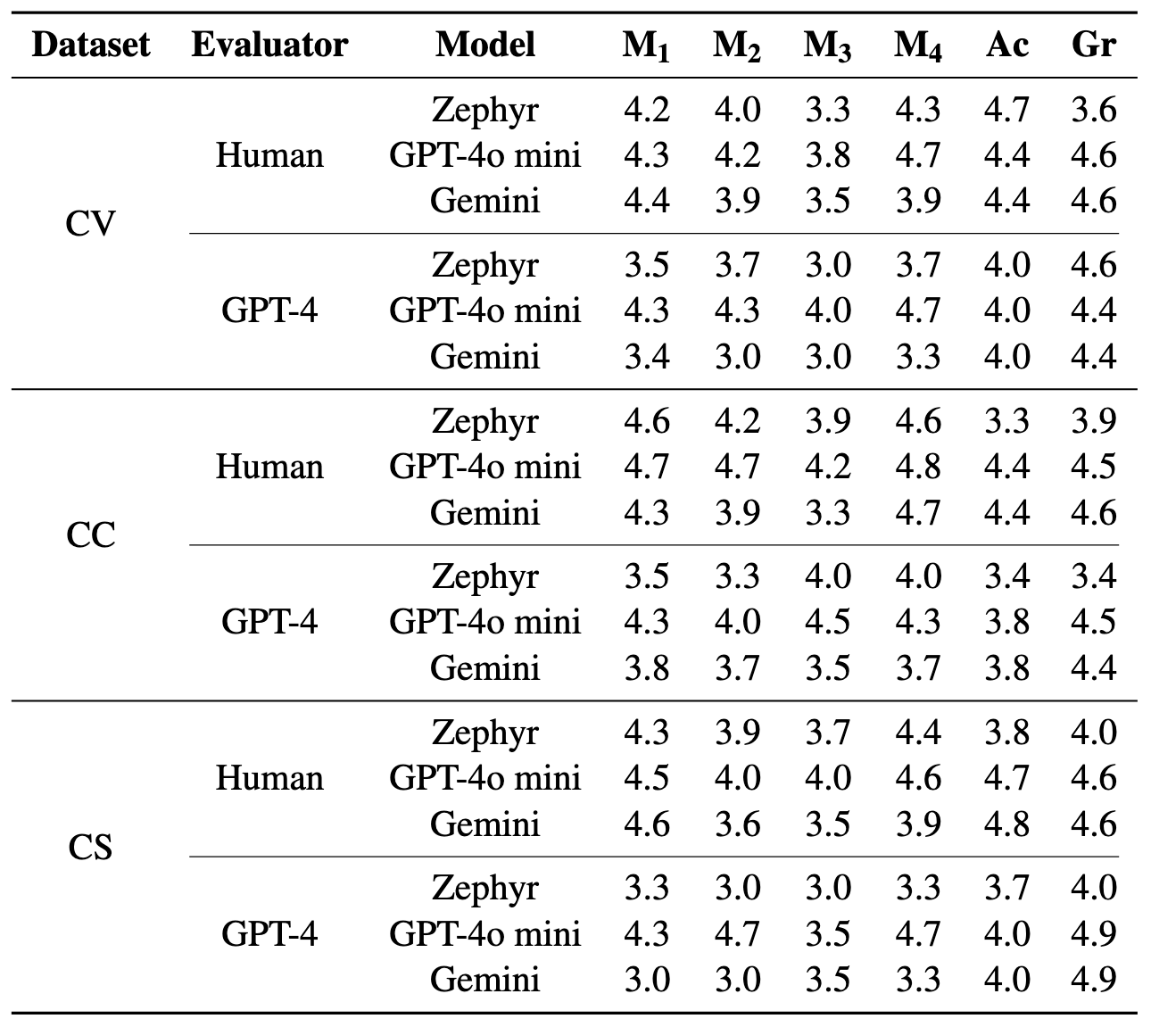
Evaluation
Models:
Zephyr 7B Beta
GPT-4o mini
Gemini 2.0 Flash
Taxonomy Evaluation:
Clarity (M₁)
Hierarchical Coherence (M₂)
Orthogonality (M₃)
Completeness (M₄)
Claim-topic Evaluation:
Accuracy (Ac)
Granularity (Gr)

Slide 14
Error Analysis:
Feedback from Human Evaluators
Overlapping of topics
E.g., “Vaccine Mandates” and “COVID-19 Vaccine Mandates”
Lack of specificity in topic labels
E.g., “Lawsuits,” “Cybersecurity”
Generation of noisy data
E.g., “not mentioned in the given post”

Slide 15
Conclusions
We introduced LLMTaxo, a novel framework that leverages LLMs to construct taxonomies of factual claims from social media within a topic domain.
The proposed framework can effectively automate a three-level taxonomy construction. The results highlight its potential in reducing redundancy and improving information accessibility.
Evaluation across different topic domains highlights its potential for broader applications.

Slide 16
Thank you!

